Slide 1
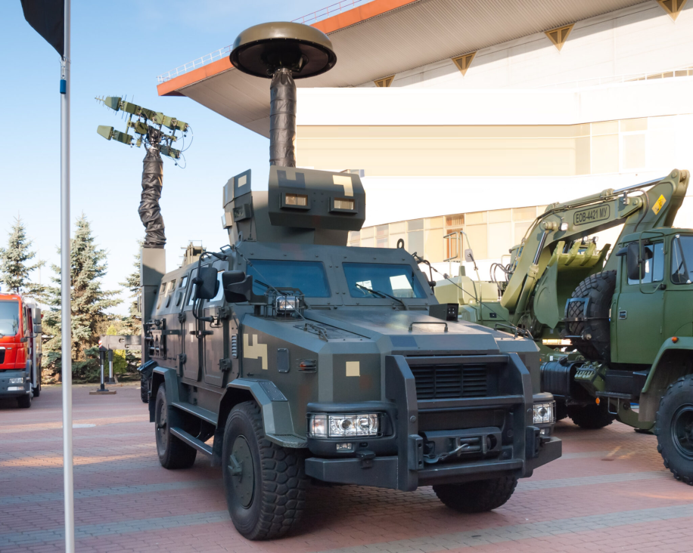
TACTICAL ELECTRONIC PROTECTION
Electronic Warfare &
Counter-Technical Reconnaissance
A modular soft-kill protection layer for critical sites, forward bases and mobile formations.
CAPABILITY OVERVIEW • CUSTOMER BRIEFING
Notes:
[Sources]
- User-supplied “NOTA EW System: Official Summary Description,” received 20 Aug 2026.
[Verification]
- Performance figures, frequency coverage, mobility claims and combat-use statements should be confirmed against the current manufacturer datasheet, export configuration and customer acceptance-test protocol.

Slide 2
One system addresses four RF-domain threats
01
Detect
Passive RF reconnaissance and automated direction finding
02
Disrupt
UAS command, telemetry and video links
03
Deny
GNSS signals inside a localized protection zone
04
Interdict
Cellular and tactical VHF communications where authorized
02
Notes:
[Sources]
- User-supplied “NOTA EW System: Official Summary Description,” received 20 Aug 2026.
[Verification]
- Performance figures, frequency coverage, mobility claims and combat-use statements should be confirmed against the current manufacturer datasheet, export configuration and customer acceptance-test protocol.

Slide 3
Passive awareness comes before active defeat
1
SENSE
2
LOCATE
Monitor the RF environment without broadcasting a radar signature.
Identify likely aerial emitters and estimate bearing to the UAV or control station.
Operator-controlled response
Jamming begins only after identification, rules of engagement and mission need are established.
03
Notes:
[Sources]
- User-supplied “NOTA EW System: Official Summary Description,” received 20 Aug 2026.
[Verification]
- Performance figures, frequency coverage, mobility claims and combat-use statements should be confirmed against the current manufacturer datasheet, export configuration and customer acceptance-test protocol.

Slide 4
Claimed coverage extends across the tactical engagement area
20 km
15 km
1 km
Passive detection
Electronic jamming
GNSS denial
UAV and ground-control RF emitters
Control, telemetry and video links
Localized GPS / GLONASS / Galileo / BeiDou zone
Indicative maximum ranges
Actual performance depends on antenna height, terrain, spectrum conditions, waveform, target link budget, installation and regulatory constraints.
Customer validation: confirm ranges in the target configuration through a witnessed field demonstration.
04
Notes:
[Sources]
- User-supplied “NOTA EW System: Official Summary Description,” received 20 Aug 2026.
[Verification]
- Performance figures, frequency coverage, mobility claims and combat-use statements should be confirmed against the current manufacturer datasheet, export configuration and customer acceptance-test protocol.

Slide 5
Layered protection for sites and maneuver units
UAS LINKS
NAVIGATION
Control • telemetry • live video
GPS • GLONASS • Galileo • BeiDou
Soft-kill response against RF-dependent UAS.
Localized denial against satellite navigation.
CELLULAR
TACTICAL RADIO
GSM • UMTS • LTE • CDMA
Selected VHF communications
Interdiction subject to national authorization.
Mission-configured suppression where permitted.
05
Notes:
[Sources]
- User-supplied “NOTA EW System: Official Summary Description,” received 20 Aug 2026.
[Verification]
- Performance figures, frequency coverage, mobility claims and combat-use statements should be confirmed against the current manufacturer datasheet, export configuration and customer acceptance-test protocol.

Slide 6

The same core capability supports two deployment models
STATIONARY / DEPLOYABLE
Protect fixed assets
• Ammunition depots
• Airfields
• Command posts
• Critical infrastructure
Rapid mast-based installation
MOBILE / ARMORED CHASSIS
Protection at halt or on the move
06
Notes:
[Sources]
- User-supplied “NOTA EW System: Official Summary Description,” received 20 Aug 2026.
- Product photograph supplied by the user, file 94f1dbc9-90c0-4d20-89b2-c1530ad66776.png.
[Verification]
- Performance figures, frequency coverage, mobility claims and combat-use statements should be confirmed against the current manufacturer datasheet, export configuration and customer acceptance-test protocol.

Slide 7
Two configurations cover fixed-site and mobile requirements
BASIC VERSION
MOBILE VERSION
€250,000
€395,000–590,000
Stationary / deployable configuration
Integrated on an armored chassis
Designed for perimeter protection of fixed sites and rapidly deployable positions.
Final value depends on platform, integration scope, antenna fit, mission configuration and support package.
Indicative commercial pricing. Taxes, delivery, training, spares and customer-specific options to be confirmed in the formal quotation.
07
Notes:
[Sources]
- User-supplied “NOTA EW System: Official Summary Description,” received 20 Aug 2026.
- Pricing supplied by the user on 20 Aug 2026: Basic version EUR 200,000; mobile armored-chassis version EUR 350,000–500,000.
[Verification]
- Performance figures, frequency coverage, mobility claims and combat-use statements should be confirmed against the current manufacturer datasheet, export configuration and customer acceptance-test protocol.

Slide 8
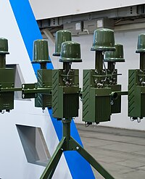
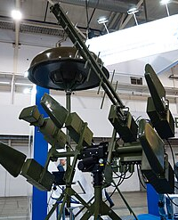
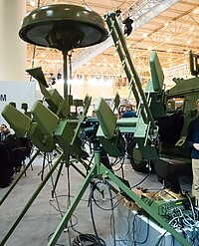

Deployable antenna modules support flexible site layouts
MODULAR MAST-BASED RF ASSEMBLIES
Configuration adapted to mission, protected site and spectrum plan.
Exhibition views of representative deployable configurations
08
Notes:
[Sources]
- User-supplied “NOTA EW System: Official Summary Description,” received 20 Aug 2026.
- Product photographs supplied by the user: 7a561774-6a57-43aa-9a28-710b655acc26.png; 55fbad6a-f551-453a-a076-aa1dd1a52f76.png; 92f34fba-c682-424b-86cd-1fb08822dbf3.png; 5dd1e76e-9f74-4257-89e9-5d8ce86776d6.png.
[Verification]
- Performance figures, frequency coverage, mobility claims and combat-use statements should be confirmed against the current manufacturer datasheet, export configuration and customer acceptance-test protocol.

Slide 9
NOTA prioritizes passive RF reach; Western peers prioritize sensor fusion
Criterion
NOTA
AUDS
Drone Dome
Sensor architecture
Passive RF reconnaissance + DF
Electronic-scanning radar + EO/IR
Radar + RF sensor + EO + C4I
Published detection
Up to 20 km — claimed
Up to 10 km system range; target-dependent
Small targets beyond 3.5 km
Threat localization
RF identification and automated bearing
Radar tracking with day/night EO/IR
Multi-sensor identification and classification
Soft-kill effect
RF links up to 15 km; GNSS zone up to 1 km — claimed
Directional RF inhibitor; range not publicly stated
Reactive RF jamming; range not publicly stated
Deployment
Fixed, mast or armored mobile
Rooftop, mast, fixed and vehicle / on-the-pause
Stationary or mobile; open architecture
Ranges are not directly equivalent: sensor type, target size, terrain and configuration materially affect performance.
09
Notes:
[Sources]
- User-supplied “NOTA EW System: Official Summary Description,” received 20 Aug 2026.
- AUDS architecture, deployment options and “up to 10 km” system range: Blighter Surveillance Systems, official AUDS material, https://blighter.com/auds-counter-drone-system-enhanced-for-vehicle-deployment-and-to-defeat-swarm-attacks/
- AUDS small-UAS performance is target-dependent: Blighter A400 official material, https://blighter.com/blighters-battle-proven-a400-series-counter-uav-radar-enhanced-to-better-detect-low-slow-and-small-drones/
- Drone Dome architecture, small-target detection beyond 3.5 km, mobility and optional laser: Rafael, official Drone Dome page, https://www.rafael.co.il/system/drone-dome-family/
[Verification]
- Performance figures, frequency coverage, mobility claims and combat-use statements should be confirmed against the current manufacturer datasheet, export configuration and customer acceptance-test protocol.

Slide 10
NOTA competes on passive surveillance, RF reach and clear entry pricing
OPERATIONAL ADVANTAGE
RANGE ADVANTAGE
COMMERCIAL ADVANTAGE
Low-signature RF sensing
Extended RF engagement area
€220k basic / €375–550k mobile
Passive surveillance supports electromagnetic discretion until the operator authorizes an active response.
Claimed passive detection up to 20 km and RF jamming up to 15 km create a broad tactical protection envelope.
Clear configuration pricing supports faster budgeting and procurement planning.
A combat-proven Ukrainian solution optimized for contested RF environments.
Modular stationary and armored configurations enable deployment across critical infrastructure, forward bases and maneuver units.
10
Notes:
[Sources]
- User-supplied “NOTA EW System: Official Summary Description,” received 20 Aug 2026.
- Pricing for NOTA supplied by the user on 20 Aug 2026.
[Verification]
- Performance figures, frequency coverage, mobility claims and combat-use statements should be confirmed against the current manufacturer datasheet, export configuration and customer acceptance-test protocol.

Slide 11
A disciplined evaluation converts capability claims into evidence
01
Mission definition
Threat links, protected area, mobility and rules of engagement
02
Spectrum plan
Permitted bands, exclusions, deconfliction and safety controls
03
Field trial
Witnessed detection, bearing accuracy, jamming and GNSS-denial tests
04
Integration
Power, mast, vehicle, C2 interface, training and sustainment
05
Acceptance
Agreed KPIs, logs, test conditions and configuration baseline
11
Notes:
[Sources]
- User-supplied “NOTA EW System: Official Summary Description,” received 20 Aug 2026.
[Verification]
- Performance figures, frequency coverage, mobility claims and combat-use statements should be confirmed against the current manufacturer datasheet, export configuration and customer acceptance-test protocol.

Slide 12
Buyer due diligence should focus on configuration and control
Performance
Spectrum
Test ranges, antenna height, target profiles and probability of detection
Exact bands, simultaneous channels, waveform library and update process
Operations
Integration
Crew size, setup time, on-the-move limits and user interface
Power demand, mass, mast loads, vehicle EMC and C2 interfaces
Compliance
Support
Export authorization, end use, national RF permissions and safety case
Training, spares, software updates, warranty and repair turnaround
12
Notes:
[Sources]
- User-supplied “NOTA EW System: Official Summary Description,” received 20 Aug 2026.
[Verification]
- Performance figures, frequency coverage, mobility claims and combat-use statements should be confirmed against the current manufacturer datasheet, export configuration and customer acceptance-test protocol.

Slide 13
Recommended next step: a controlled customer demonstration
1
Share
2
Define
3
Demonstrate
Current export datasheet and proposed configuration
Customer threats, site geometry and spectrum constraints
Witnessed trial with agreed test conditions and KPIs
RF-domain protection engineered for contested environments.
13
Notes:
[Sources]
- User-supplied “NOTA EW System: Official Summary Description,” received 20 Aug 2026.
[Verification]
- Performance figures, frequency coverage, mobility claims and combat-use statements should be confirmed against the current manufacturer datasheet, export configuration and customer acceptance-test protocol.

